Slide 1
BUSQOM 1080 Logistic Regression I
Fall 2020
Lecture 19
Professor: Michael Hamilton

Slide 2
Lecture Summary
Today: An introduction to logistic regression
How to do regression with binary response [10 Mins]
Logistic Regression: linear regression through the logit function [10 Mins]
Logistic Regression in R [20 Minns]

Slide 3
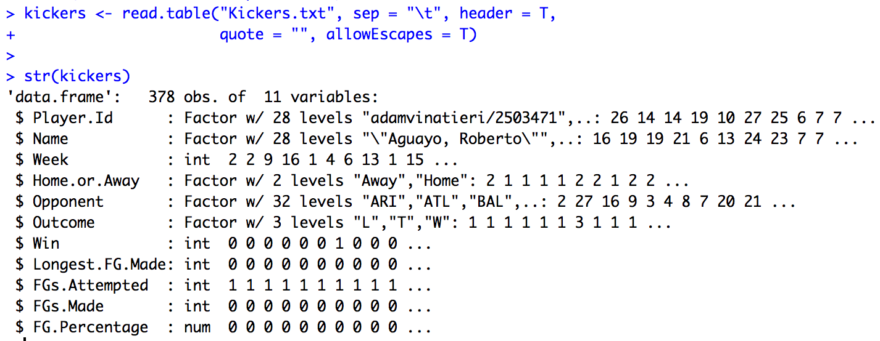
Data for lecture
Data for the 2016 NFL Regular Season
Starting kicker stats including FG.Percentage, whether the team won the game, etc.

Slide 4
Topic: Regression with Binary Responses
So far we’ve seen linear regression to learn a relationship between a numeric response variable and some numeric or categorical features.
Often we want to predict a binary (0 or 1) response.
Example: Do you have high blood pressure? Can we predict it high blood pressure from diet and demographic information?
Example: Did you have a concussion? Can we predict it from information on your medical chart?
Example: Is an email message an unsolicited commercial email (spam)? Can we predict it from timing and text analysis?
We can’t use the usual linear regression here because the response is binary.

Slide 5
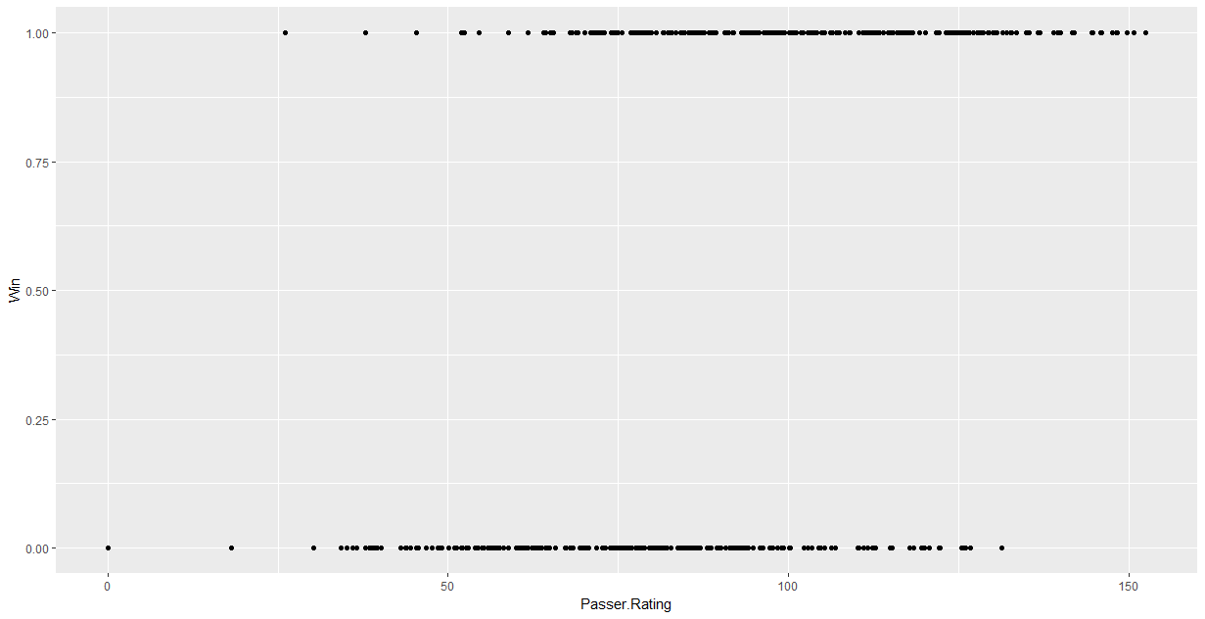
Example: Plot Wins ~ FG.Percentage
Suppose we want to predict a whether football team wins a game using the teams Field Goal Percentage (how often the kicker can successfully hit the ball through the posts)?
Data looks like:
Win?
FG.Percent

Slide 6
Models to fit binary response data
Idea 1: We could try and use a regular regression between Wins and PG%. Regression will capture the relationship between Wins and PG%.
Problem: The output of the linear regression isn’t 0 or 1 i.e. Win/Lose. So how do we interpret the results?
Goal: We need a method that can tell us how much the starting Kickers FG.Percentage influences the team’s success (wins)

Slide 7
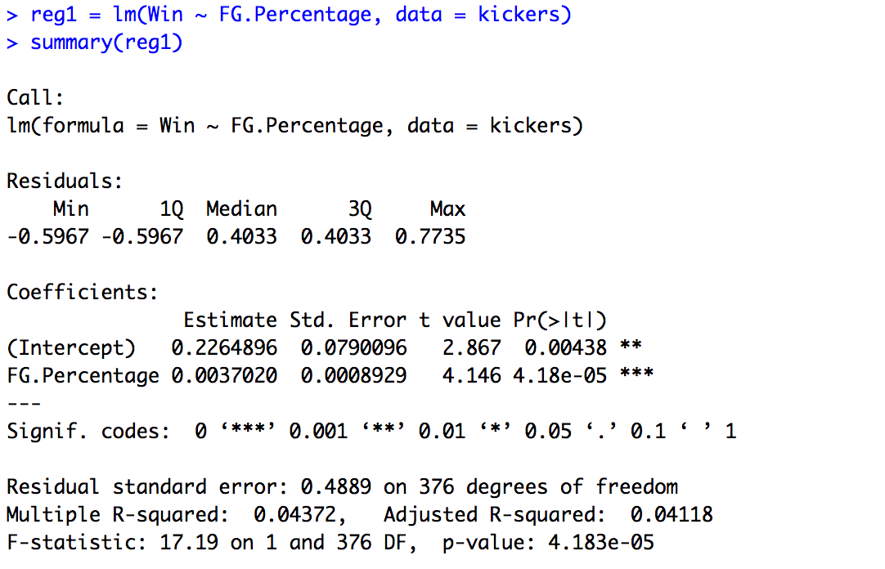
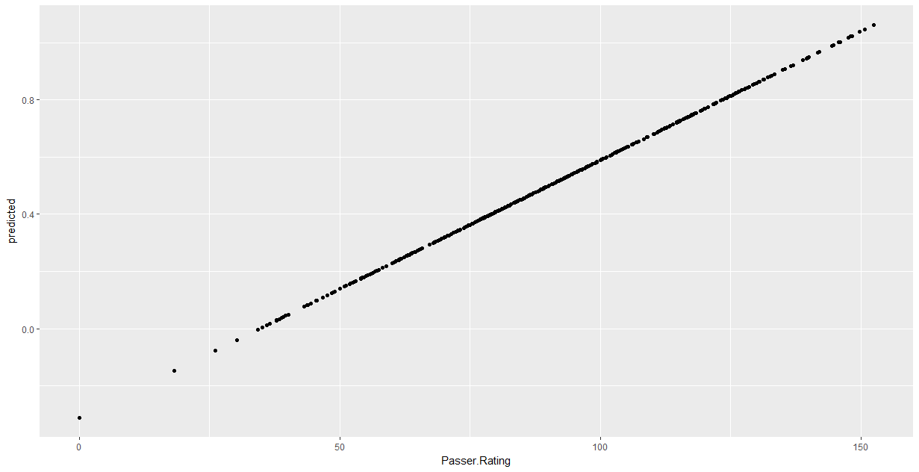
Idea 1: Simple linear regression?
Y = β₀₊ β₁ X
Win Prob.
Does not limit predicted values to 0 and 1
FG.Percent

Slide 8
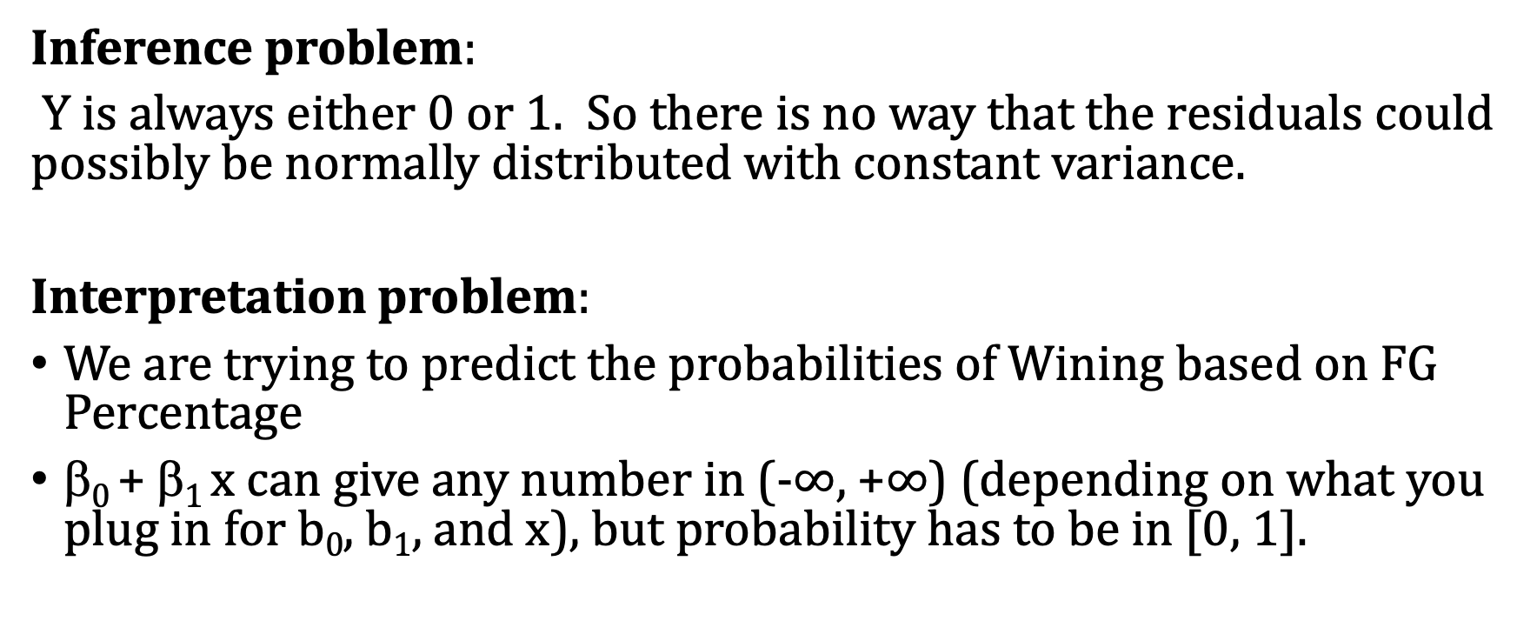
Reasons regular linear regression won’t work
Inference problem:
Y is always either 0 or 1. So there is no way that the residuals could possibly be normally distributed with constant variance.
Interpretation problem:
We are trying to predict the probabilities of Wining based on FG Percentage
β₀ + β₁ x can give any number in (-$∞$, +$∞$) (depending on what you plug in for b₀, b₁, and x), but probability has to be in [0, 1].

Slide 9
Idea 2: Logistic Regression
Logistic regression is a variation of linear regression in which we can predict the probability of a categorical response variable from feature information.
The easiest case is one in which the outcome variable is an indicator (0/1) variable (binary) although the method can be extended to multiple classes.
This will require modifying our regression framework to keep model responses between 0 and 1.

Slide 10
Regression to predict probabilities
Problem: Probabilities are always between 0 and 1!
Idea: We might try to do a special kind of transformation on our linear regression equation that makes it’s outputs interpretable as probabilities. i.e. a way to take arbitrary numbers and smoosh them into [0,1].
Solution: Find a monotone “link function” that takes the predicted number and transforms it into a number between 0 and 1 that we can interpret as the probability.

Slide 11
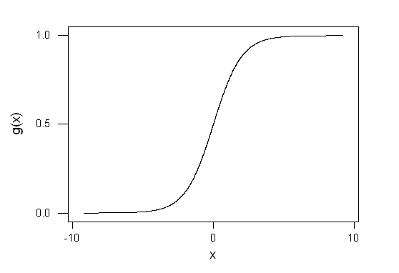

Linear Regression via the Logit Link
The most commonly used function here is the logistic or “logit” link
Let t = $β$₀ + $β1$x , logit func. g(t):
As t tends to -∞, g(t) tends to 0
As t tends to ∞, g(t) tends to 1

Slide 12
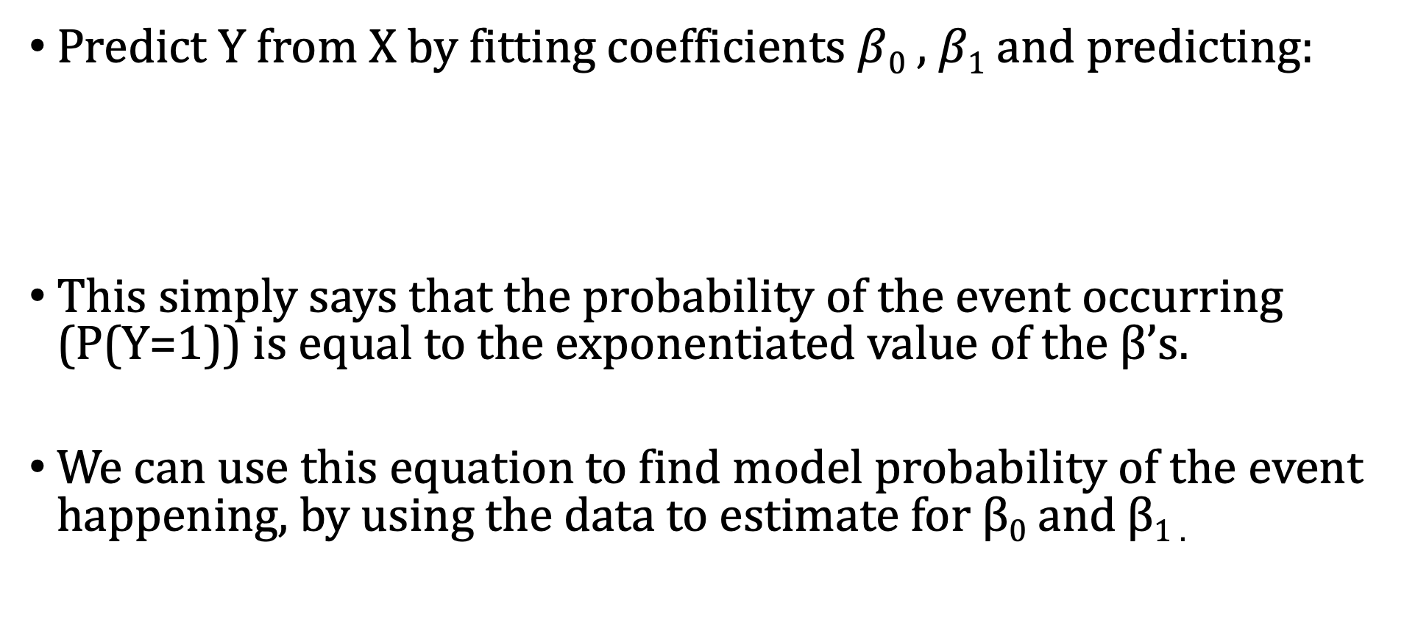
Simple Logistic Regression
Predict Y from X by fitting coefficients $β$₀ , $β1$ and predicting:
This simply says that the probability of the event occurring (P(Y=1)) is equal to the exponentiated value of the β’s.
We can use this equation to find model probability of the event happening, by using the data to estimate for β₀ and β_{1 .}

Slide 13

How to Fit $β$₀ , $β1$?
The inverse of the logit function is
Some algebra shows that the model is equivalent to saying that:
In logistic regression we are estimating a linear equation to predict the natural logarithm of the odds of success (the “log odds”).
Def: Odds Ratio

Slide 14
Interpretation of Simple Logistic Regression
Then for every unit increase in x, the model will predict an increase of β₁ units in the log-odds:
If β₁=0, then X has no detectable relationship with Y (as with linear regression previously).
If β₁<0, then higher X values are associated with lower success probabilities for Y.
If β₁>0, then higher X values are associated with higher success probabilities for Y.

Slide 15
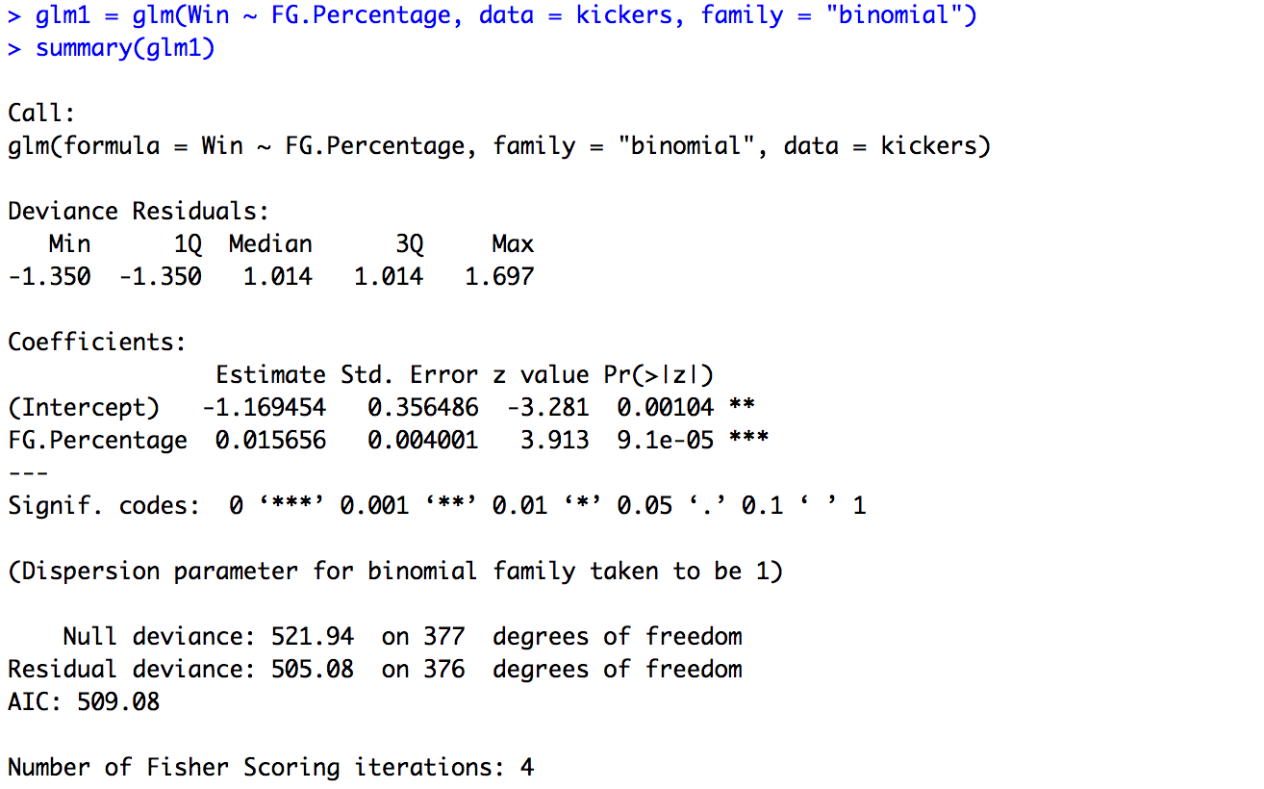
Logistic Regression in R via glm() function
Logistic regression versus linear regression:
Use glm() instead of lm()
Same formula
Tell R to use logit link (family = “binomial”)
Use summary() function to view results
Results include table of coefficients & model fit

Slide 16
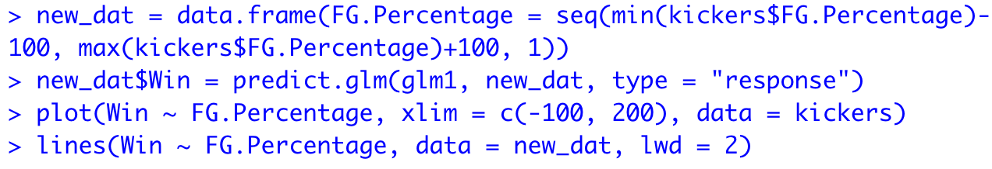
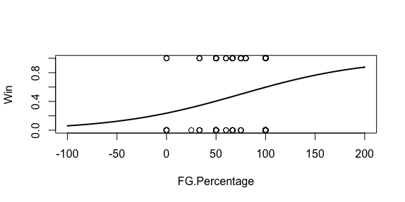
Plotting Logistic Regression in R
We’re making a new dataframe to help plot out points
The predict.glm function fits our model on points
The lines function adds the curve in to the previous plot (lwd = 2 makes curve!)
To plot Logistic Regression
First build a new data frame consisting of evenly spaces pts on the x-axis and the fit of the model on those pts
Make sure that data frame uses the same columns names as your trained model!
Next plot your points from your original data frame
Then use the lines function to plot the curve using points from your new/fitted dataframe.

Slide 17
Fitted values now represent the probabilities
Greater than 50%
probability of winning
Less than 50%
probability of winning
FG.Percent

Slide 18
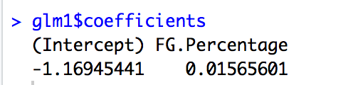
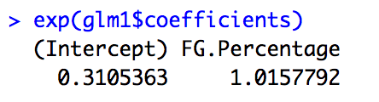
More on interpreting the intercept
If all of the predictor coefficients are zero, then the odds of success are π/(1- π) = exp(β₀) (by algebra!).
If the starting kickers FG.Percent is zero, then the odds of winning are π = exp(-1.169)/(1+exp(-1.169)) = 0.237

Slide 19
More on interpreting the “slope” in general
If β_{i} > 0, then the odds of observing the event become higher if X_{i} is higher.
If β_{i} < 0, then the odds of observing the event become lower if X_{i} is higher.
If β_{i} = 0, then X_{i} does not tell us anything about the odds of observing the event.
More specifically, whenever X_{i} goes up (or down) by c units, the odds are multiplied (or divided, respectively) by exp(β_{i}c)=exp(β_{i})^{c} units.
Each predictor’s coefficient is the log of a particular odds ratio.

Slide 20
Other link functions: Logit & Probit
Math fact: The logit link function is the CDF of a probability distribution known as the logistic distribution. In some sense, logistic regression uses this link function because it maps nicely to this distribution. It’s learning a parametric form of the CDF.
There is also a similar form of binary regression that uses the normal distribution CDF (probit regression)
Probit is similar to logistic regression but a little less flexible and seems to be less favored
In this class, we will only talk about logistic regression with the logit link, but you may be interested to learn about different ones for your project!

